Slide 1


Taking Steps to Empower Women in PROGREEN and FOLUR Landscapes: REDD+ meets W+ in Nepal
World Bank
2 February 2023

Slide 2

Who We Are
WOCAN's purpose is to advance women’s empowerment and collective action to tackle climate change, poverty and food insecurity within enabling environments.
US –registered global network with over 1400 Members in 114 countries, who have expertise in agriculture and NRM
25 Core Associates, trainers and W+ Experts in Africa and Asia
Provider of gender and climate services for gender training, assessment, gender action plan development and technical assistance for W+ Standard

Slide 3
Capacity building and TA for gender in landscape and related climate sectors
Activities
WOCAN provides solutions for climate fund requirements; women’s empowerment programs for renewable energy, climate-smart agriculture, and forest and water management projects. clients include the Forest Carbon Partnership Facility, Green Climate Fund, Nepal and Pakistan’s REDD+ Programs, etc.
Conduct stakeholder and gender analyses
Design gender-responsive climate strategies and Gender Action Plans
Provide coaching and technical assistance as needed to implement GAPs
Training: leadership skills for women and men
Training: implement, monitor and measure results
Measure impacts using the W+ Standard™
Increased effectiveness and gender-equitable benefit-sharing within forest and climate projects and investments
Outcome measurement for projects that meet the requirements of the W+ Standard™
Results-based payments through sale of W+ credits or W+ labelled carbon credits to meet market demands for social co-benefits and SDG impacts, returning revenues to project developers, funders and women in project communities.
Results

Slide 4
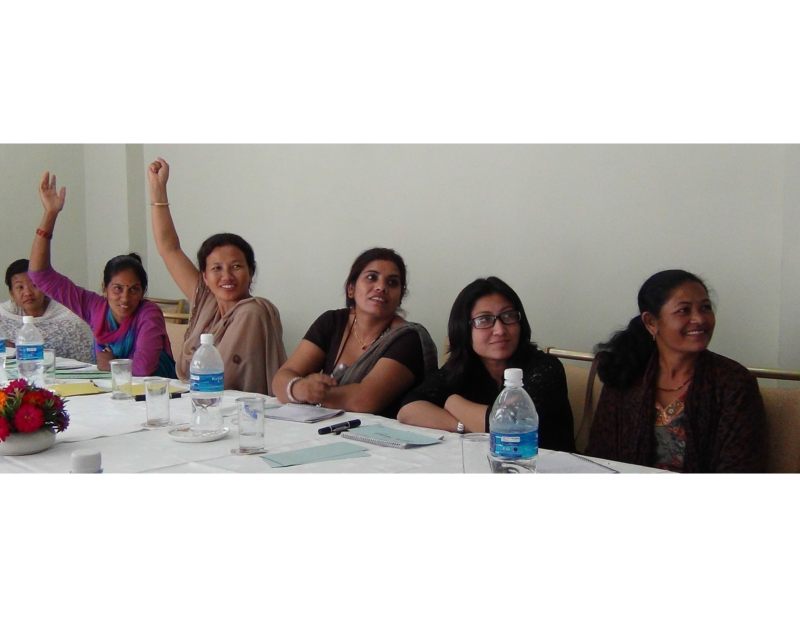
Genesis of the W+ Standard
Why did WOCAN design a standard?
Gender mainstreaming alone not producing desired results
Need to incentivize agencies to increase attention to gender /women’s empowerment
Seeking ways to provide revenue to women’s organizations
Inspired by carbon measurement and markets as a rigorous way to monetize environmental impacts and channel capital to fund projects.

Slide 6
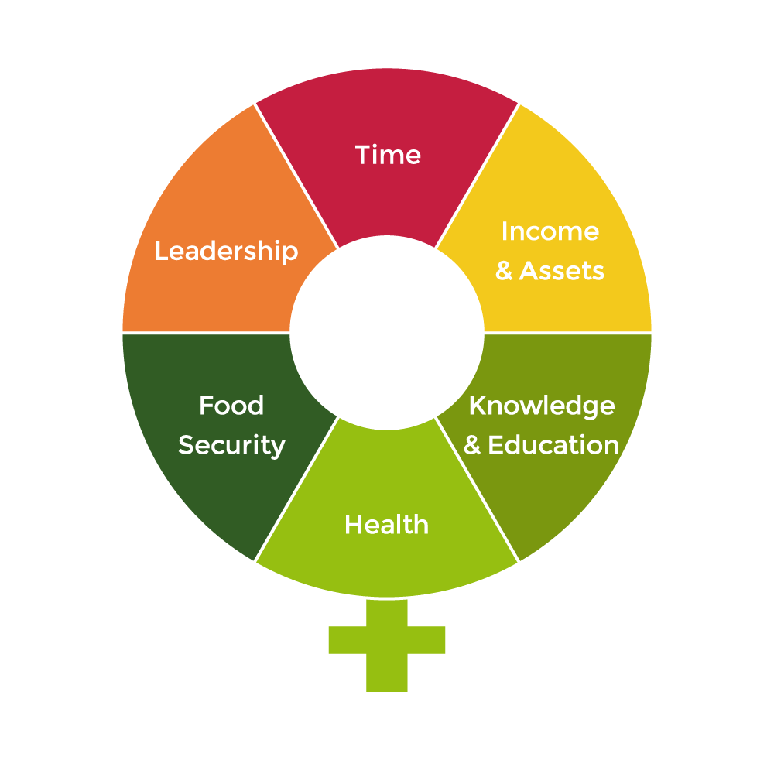
The W+ Standard
What it is: standard/certification framework that provides metrics and procedures to quantify, verify and monetize women’s empowerment results within projects and supply chains.
What it Does: provides framework for designing as well as monitoring results within projects and generates W+ units - quantified and verified units of improvement in women’s conditions from a baseline in six domains. 1 W+ = 10% impact for one woman within the monitoring period.
Value for Climate: can be combined with GHG units as a co-benefit (ex. W+ labelled Verified Carbon Unit or stacked onto Voluntary Emission Reduction units) to simultaneously address SDGs for gender and climate.
Sharing value with women
At least 20% of the revenue from W+ unit sales is granted to women’s groups engaged in the project to be utilized as they see best fit to address community and climate adaptation needs and opportunities.
Momentum for Change Award 2016
Notes:
Give example relevant to forestry (tree nursery, for income generation)

Slide 7
Value of the W+ Standard to Landscape and Climate Funds
Enhance project design for gender and women’s empowerment, using W+ Standard as design and monitoring framework
Provides results-based measurement and reporting for donors, corporates and investors for SDG target # 5
Stories and qualitative metrics beyond numbers of women
Use for climate projects funded by the World Bank, GCF, development organizations, companies and private sector funds, measuring results and generating W+ units or W+ labeled carbon credits
5. Linked to VCS (Verified Carbon Standard) to enable streamlined process to generate W+ labeled carbon credits
Increased gender integration in project proposals presented, for outcomes
Increased confidence that projects and activities are producing results that include and benefit women, avoiding risk of ‘pink washing’
Revenue source for sustainability of activities through sale of W+ units
Grant funds to women’s groups through benefit sharing mechanism
Results

Slide 8

How it Works

Slide 9



Who benefits? Triple win solution
$
$
W+ Unit
W+ Unit
W+ Unit
$
$
$
$
$
$
WOMEN
CLIMATE PROJECT DEVELOPERS
UNIT BUYERS
Benefits and revenue for women engaged in the project
[ At least 20 % ] to support adaptation activities
Reimbursement for costs of project activities & measurement plus funds for additional project activities
Verified outcomes for SDG #5 and
social returns

Slide 10
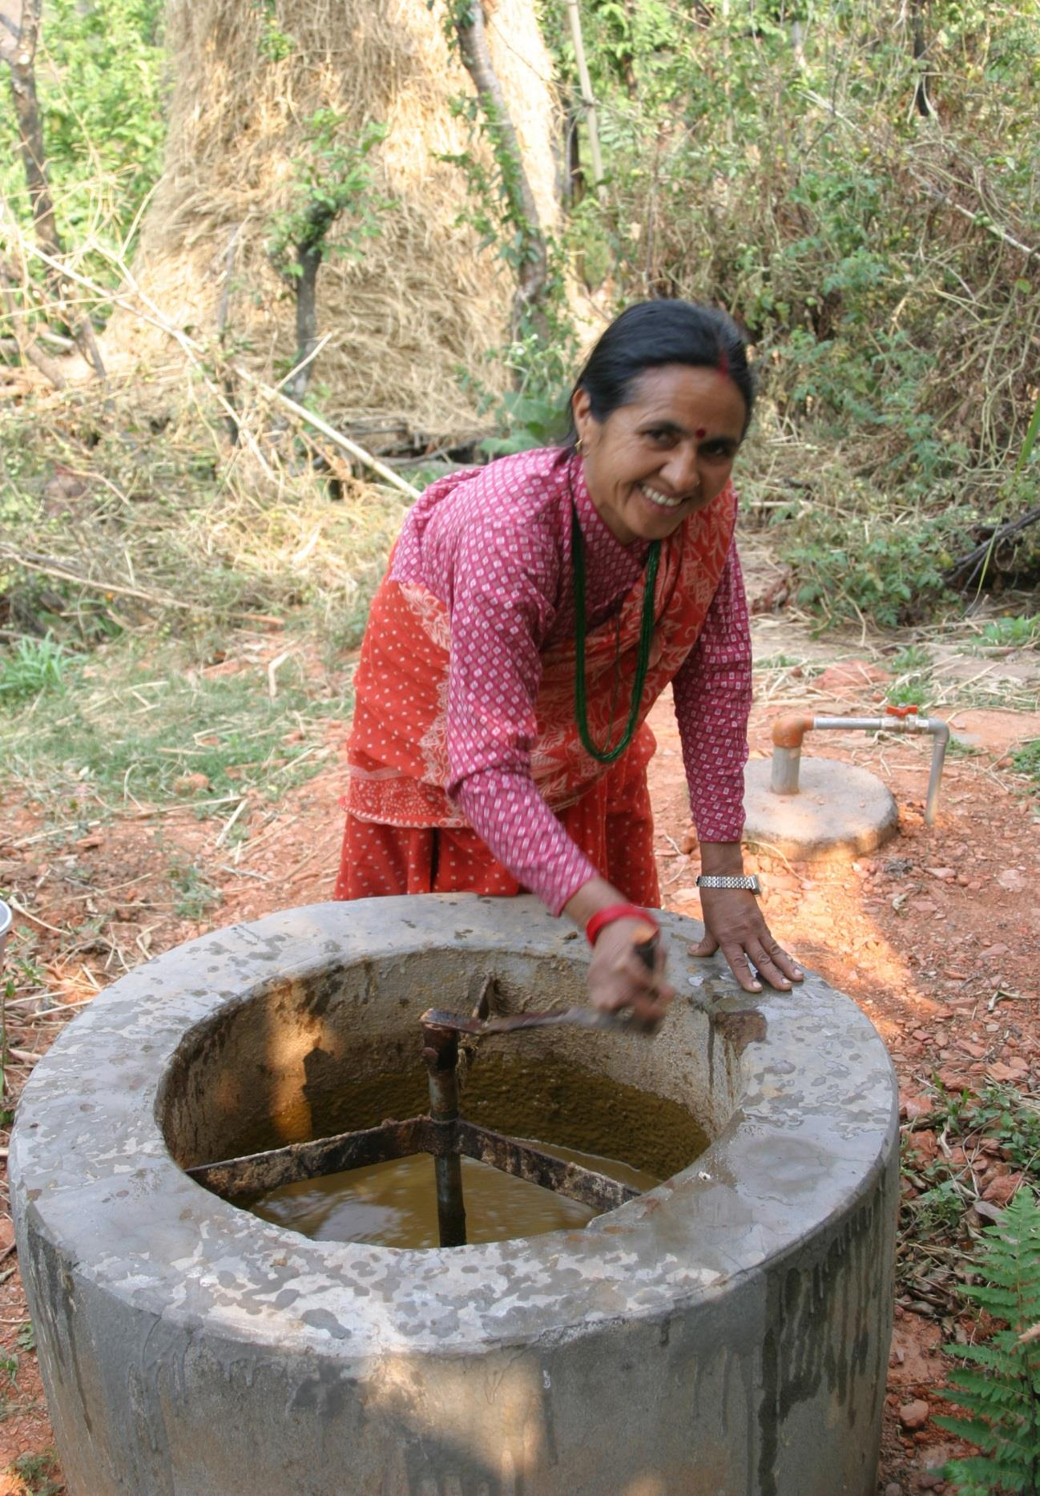
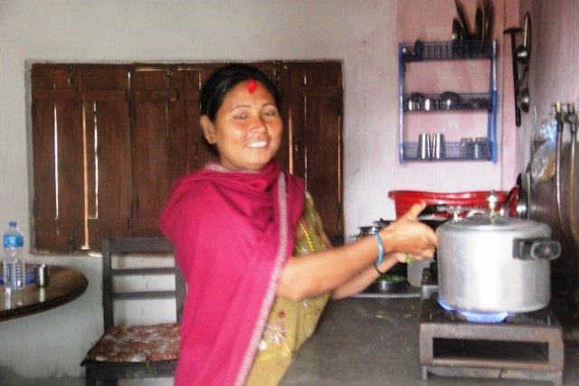
Example: Using the W+ to measure time savings from biogas
Govt. provided biogas units and measured/sold GHG units. Women’s unpaid labor has enabled functioning and maintenance of biogas digesters resulting in climate mitigation, forest conservation and GHG units.
W+ Standard measured the time saved for 7,200 who replaced their wood-generated stoves, relieving them of the need to collect fuel wood from the forest and saving 2.26 hours per day.
By eliminating this time-consuming, labor-intensive task, women gained time for leisure and self-improvement, planting vegetable gardens, and engaging in income generation and community activities.
Women’s groups received revenue from W+ unit sales, used for livelihood and climate adaptation activities.

Slide 11
Global applications of W+ Standard™
Energy access:
Biogas in Nepal, Indonesia
Water access:
South Africa
Transport:
Kenya
Women’s economic empowerment:
South Africa, Kenya, Morocco, Vietnam, Ghana, Dominican Republic
Agriculture:
Agribusiness, Kenya
Sustainable rice, Cambodia
Forest conservation:
REDD+, Kenya
Agroforestry:
- Brazil
CSR:
South Africa
Impact-linked finance:
Country TBD for DFIs
Notes:
15 to date

Slide 12
World Bank PROGREEN: Capacity Development for
Designing and Measuring Gender Outcomes through a Certification System for
Gender Inclusion in Landscape and Restoration projects
Activities: Nepal Dec. 2022-Feb. 2023
Conduct meetings with senior managers to generate interest and buy-in (Dec. 2022)
2. Selection of 10-12 women and men participants to be trained, based on criteria such as experience with impact/evaluation methods and gender analysis (in process)
Deliver training through online sessions over 4 days to introduce the concept of outcome measurement, steps of the W+ Standard and the methods for each of the six domains (Feb. 2023)
4. Hands-on training at project field site for gender analysis, community consultations, and development of indicators and survey questions, over 7 days. Participants will produce the Project Design Document and baseline study, with a schedule for the remaining monitoring activities.
5. Participants will return to project site at later date for 4 days to conduct data collection and analysis for Monitoring and Results Report.
Notes:
for building skills within their organizations to integrate gender-based outcomes in their planning and the measurement of impacts, specifically the benefits of the W+ standard as a method for identification of gender-based outcome indicators for integration into landscape program design, and tools for measuring the impacts
This will also include a baseline of participants’ existing skills for evaluation and gender analysis methods.

Slide 13
Selection criteria for W+ Trainees
Experience with gender and/or social inclusion integration into project design/planning
Experience/willingness to learn collect and analyze data data
  - Quantitative and qualitative data
Willingness and interest to go beyond ‘advocacy’ approaches to research

Slide 14
Steps in W+ Training Course
 | Content | Days Required | Method
Step 1 | Introduction to W+ Standard | 2-4 | Online
Step 2 | Domain Selection | 7 | Onsite
Step 3 | Project Design Document (PDD)
Step 4 | Baseline survey
Step 5 | Monitoring Results | 4 | Onsite
 | Mentoring Support | As needed | Online / in person

Slide 15
Step 1: Pre-Application Assessment and Domain Selection
Online
orient project staff on W+ Standard and its steps
identify gaps and opportunities in existing project activities that could be built upon to generate (additional) impact
c. determine appropriate W+ domains
prepare Project Idea Note
Notes:
15 to date

Slide 16
Step 2: Project Design Development (PDD)
a. identify potential benefit sharing mechanisms through consultations with stakeholders both within the community and larger context and Project personnel
b. conduct gender analysis and consultations with women and men of the project communities
c. develop survey questionnaires for each domain to be used
d. develop a Monitoring Plan, based on the following:
specific indicators of the W+ domain to be used for each expected result
determination of sampling size
schedule for baseline and results monitoring
e. prepare the draft Project Design Document (PDD) to be reviewed then submitted by the Project Developer to the W+ Standard for registration.
Notes:
15 to date

Slide 17
Step 3: Baseline Measurement
a. conduct baseline survey
b. identify and train enumerators (local women)
c. implement baseline survey using phone app
d. write up report
Notes:
15 to date

Slide 18
Step 4: Monitor results as per Monitoring Plan and prepare Monitoring and Results Report
a. conduct results survey using same questionnaire
b. supervise data collection by local enumerators
c. input and tabulate data
d. analyse data
e. prepare Monitoring and Results Report
Notes:
15 to date

Slide 19
Step 5: Verification and
Step 6: Issuance
a. Verification: site visit and report preparation by W+ accredited auditor (Social Audit Network, (https://www.socialauditnetwork.org.uk)
b. Issuance: W+ Standard through WOCAN issues W+ units based on W+ Verifier’s report; these are now entered into the IHS Markit registry and can be sold.
c. Once units are sold, at least 20% of sales revenues are provided to women’s groups, as stipulated in the PDD.
The last steps are not included in this PROGREEN initiative, but could be conducted in a subsequent phase.
Notes:
15 to date

Slide 20
Reflections from previous trainings
Challenges of training W+ experts
  Outcome versus Output measurement
  Combining quantitative and qualitative information
  Staying within the ‘Attribution’ boundaries
  Onetime training insufficient
  Long term capacity development/mentoring required

Slide 21
Reflections from Nepal experience to date
  1. Need for prior W+ ‘Readiness’ phase to build awareness of W+, get
  ”buy-in” from stakeholders at local, regional and federal levels (3 workshops)
  2. Value of exposure visit of local women to see what women of other areas have done, to understand what is possible within a landscape project framework
  3. Selection of trainees should be done carefully and in close consultation with Project and Ministry implementing activities, to build cadre of champions for monitoring gender impacts.

Slide 22
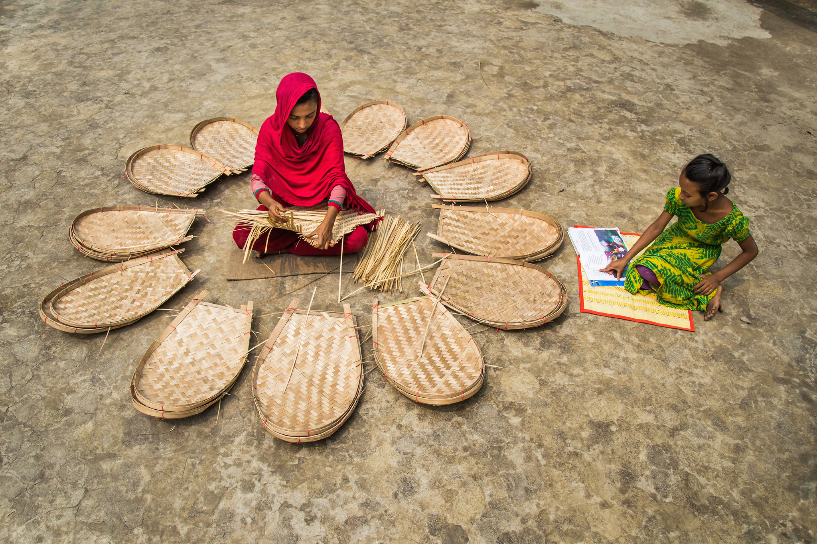

Jeannette Gurung @ jeannettegurung@wocan.org
www.wocan.org
www.wplus.org

