Slide 1
3/21/2024 | Sara Seavey, Gender Specialist (Agribusiness), IFC
Jyoti Dar, Gender Specialist (Agribusiness), IFC

Slide 2
Business Case

Slide 3
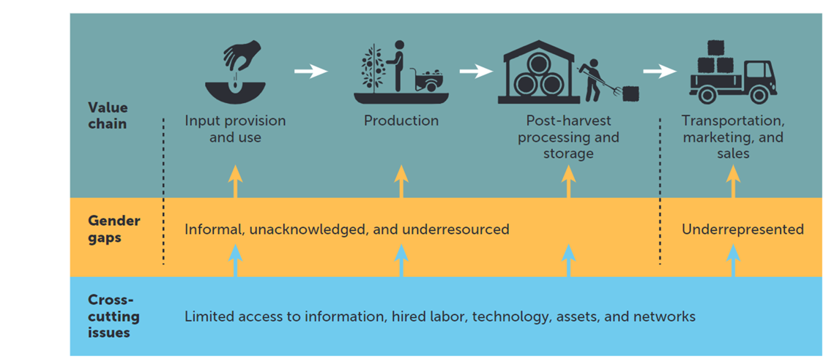
Gender Gaps in Agribusiness Value

Slide 4










Challenges Women Smallholder Farmers Face in Agribusiness Value Chains

Slide 5
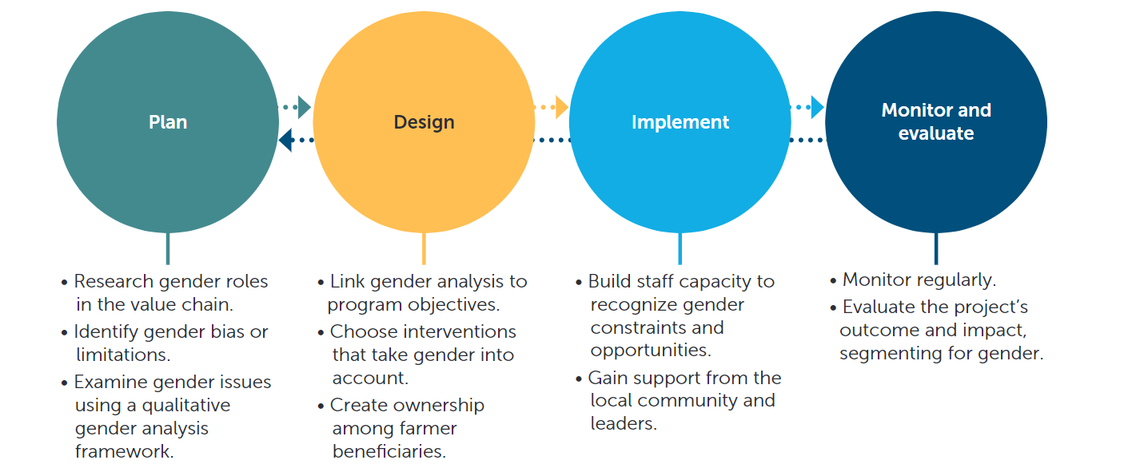
Gender Throughout the Program Design and Implementation

Slide 6
Gender-Smart Agri Solutions

Slide 7
Illustrative list of Gender-Related Performance Indicators
Number of female farmers reached (directly and indirectly)
Number of female smallholder farmers reached
Number of employees participating in training (disaggregated by sex)
Number of extension agents recruited (disaggregated by sex)
Number of suppliers and distributors in the company’s value chain (disaggregated by sex)
Number of agreements signed between farmers and off-takers per year (disaggregated by sex)
Number of women participants in workshops, training events, seminars, conferences, and so forth
Amount of savings achieved for women farmers or cooperatives
Number of participants in gender-based violence and harassment training (disaggregated by sex)
Number of gender-based violence policies or procedures implemented
Number of persons accessing childcare services (disaggregated by sex)
Percentage of group leadership positions held by women
Number and/or percentage of women farmers using fertilizer and other inputs

Slide 9


DCM Shriram | Untapping the Potential of the Sugarcane Sector
Publications
Sunita procured 833 seed nursery trays and developed 50K high-quality seedlings, of which she sold 35K seedlings across six farmers covering 4.5 acres of land.
“My family and I used to buy seedlings from middlemen at a high price. Now we sell them directly to the farmers, and they are better quality. I would like to grow more seedlings and build my business”
Sunita, Sugarcane Entrepreneur

Slide 10



